Slide 1

Event-based Camera Classification using Hyperdimensional Computing
Paul Loer
Technical University of Munich
TUM School of Computation, Information, and Technology
Chair of AI Processor Design
Munich, July 8, 2024

Slide 2
Contents
Event Data
Encoding Strategy
Results
Documentation
Paul Loer | Technical University of Munich | July 8, 2024

Slide 3
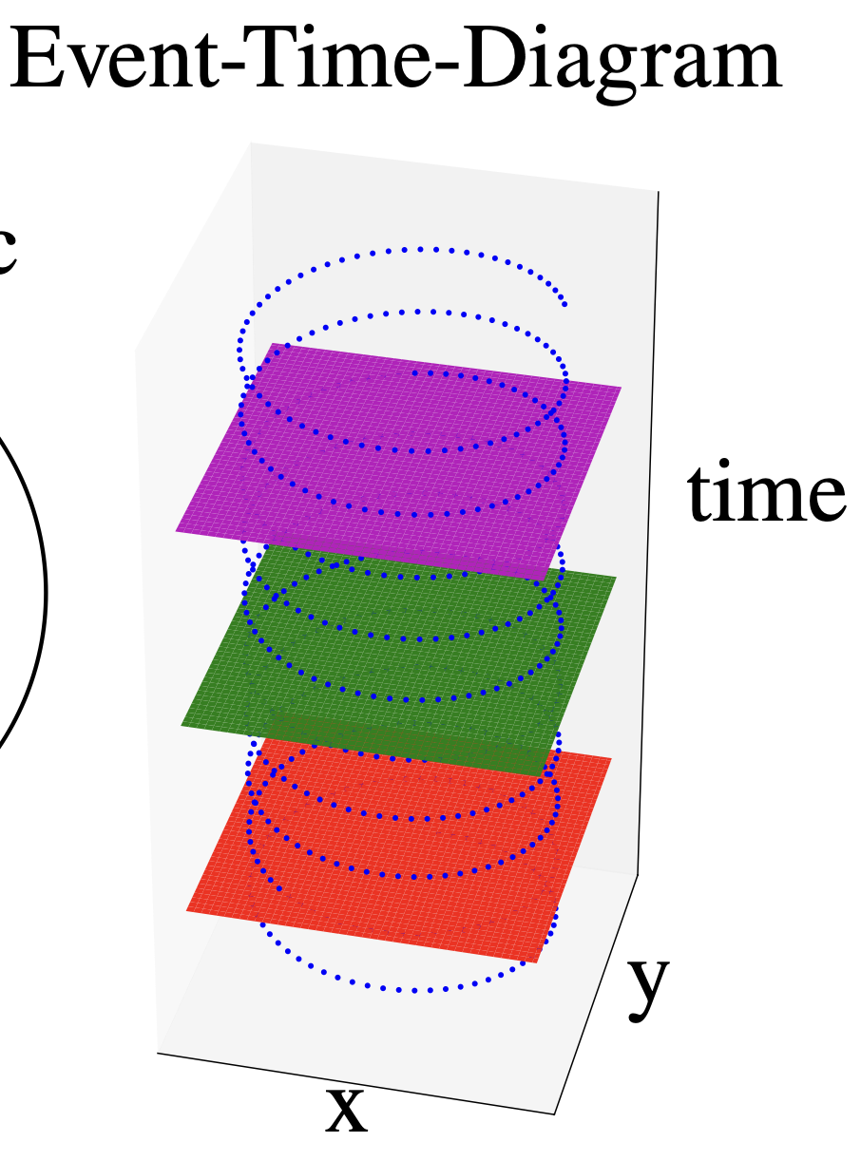
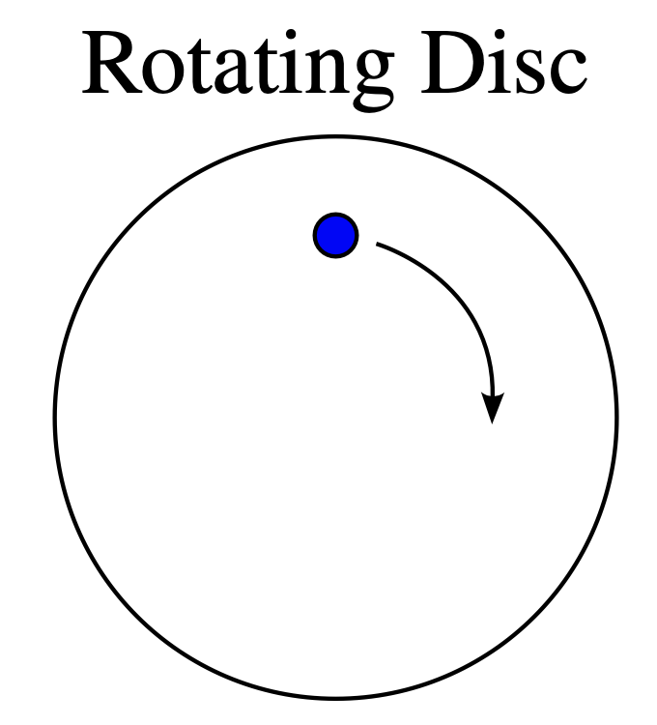
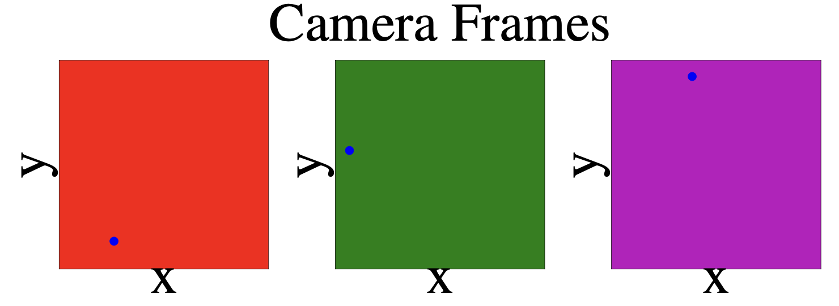
Event Data
Paul Loer | Technical University of Munich | June 28, 2024

Slide 4
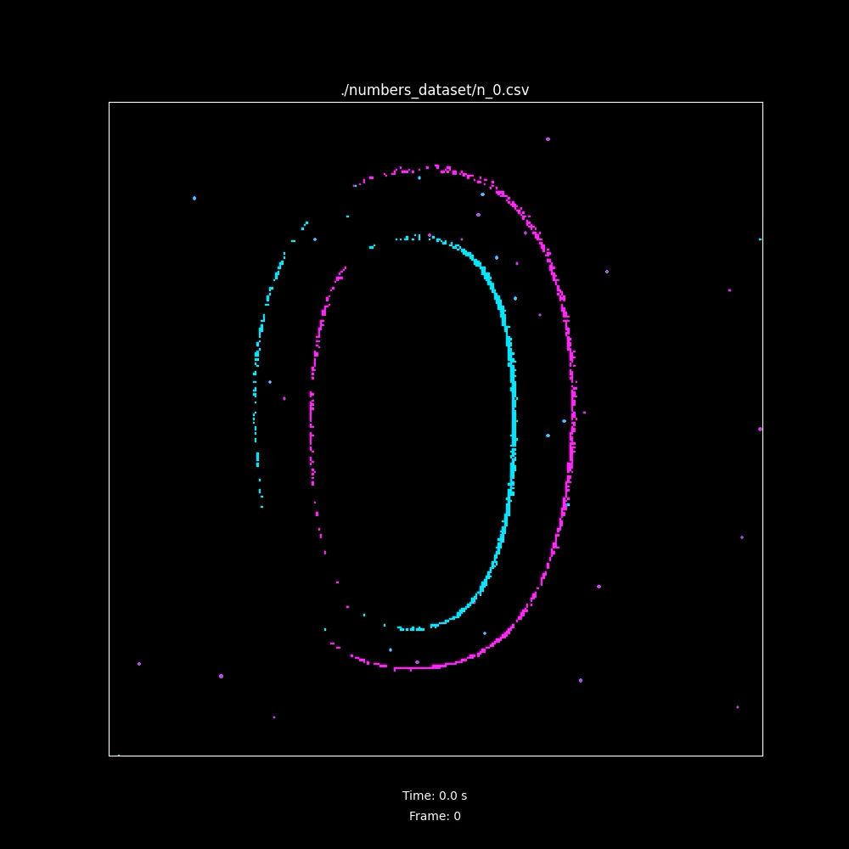
Event Data
Paul Loer | Technical University of Munich | June 28, 2024

Slide 5
Event-based Camera
Model: Prophesee GENX320
Resolution: 320x320, 0.1024 MP
Sampling frequency: 10,000 kHz

Slide 6
Encoding Strategy
Inspiration by: Hassan, Eman & Zou, Zhuowen & Chen, Hanning & Imani, Mohsen & Zweiri, Yahaya & Saleh, Hani & Mohammad, Baker. (2023). Efficient Event-Based Robotic Grasping Perception using Hyperdimensional Computing. 10.21203/rs.3.rs-3329717/v1.
Spatial Encoding: sensor area is divided into kxk spatial windows with orthogonal corner hypervectors, hypervectors in between are generated from these, such that close pixels are more orthogonal than others
Temporal Encoding: level-based orthogonality for each microsecond in the time frame
Polarity Encoding: two orthogonal hypervectors for on- and off-event
Paul Loer | Technical University of Munich | June 28, 2024

Slide 7
Encoding Strategy

Slide 8
Results
Paul Loer | Technical University of Munich | June 28, 2024

Slide 9
HDC Setup
HRR Vectors of dimension 1,000 to handle high-dimensional input data
k is set to 32
Associative Memory:
102,400 spatial vectors,
100,000 temporal vectors,
2 polarity vectors
Item Memory: 10 hypervectors for numbers 0 to 9

Slide 10
Documentation
Dataset: Numbers 0 to 9
Recorded with Prophesee GENX320
Numbers printed out on A4 sheets of paper and held into camera at a distance of 20 cm
Code and Dataset available at https://github.com/paulloer/hdc_for_dvs_data
process_dvs_data.py to process DVS data
HDC learning
calculates interference accuracy
create_video.py for transforming event data to frame-based video in .mp4 format
Paul Loer | Technical University of Munich | June 28, 2024

Slide 11
Further Steps
Acquire more complex dataset with classes other than printed out numbers
Test different encoding strategy, e. g.
one based on preceding feature extraction (SparseHD)
using holographic hyperdimensional spikes(EventHD)
Compare HDC performance to Spiking Neural Network (SNN)
Code available here
has to be adapted to asynchronous data stream of DVS
Paul Loer | Technical University of Munich | June 28, 2024

